Slide 1
ENTITY MATCHING SYSTEM COMPARISON
Baran Kaya

Slide 2
outline
Introduction
Related Works
Datasets
Systems
Experiments & Evaluation
Future Work

Slide 3
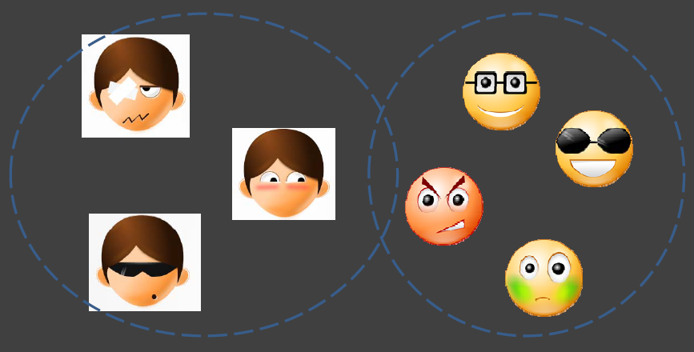
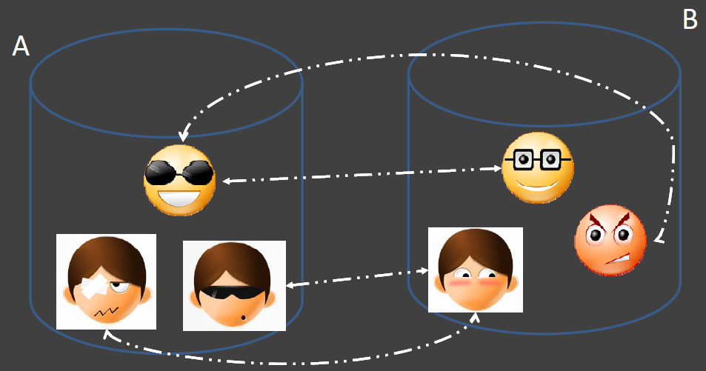
Introduction
Entity matching
Deduplication
Record linkage

Slide 4
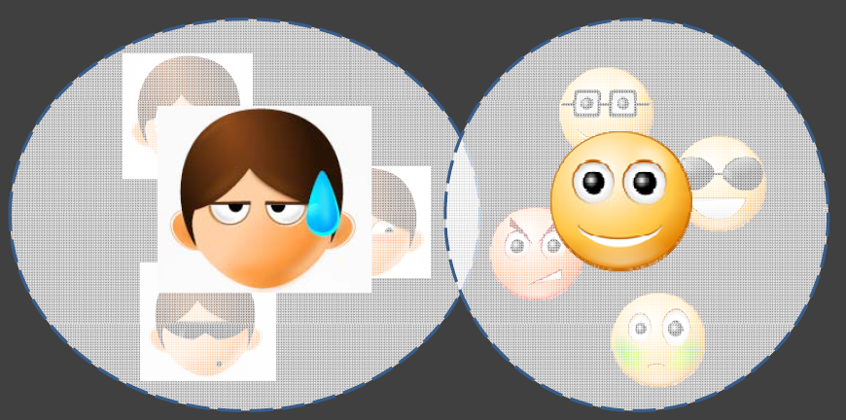
Introduction
EM is an important topic
Lost of algorithms
A few implementation/systems
A few survey/comparison papers
Research based VS Commercial
4 metrics
Runtime
Accuracy
Usability
Features
Notes:
Introduce your area
Why it’s important
Problem?
Solution? –how works, good?, interesting, new things?

Slide 5
Related works
6 similar papers:
11 Framework comparision [5] ➔ Research only
37 Quality tools [6] ➔ Commercial & Research
Dedup. Detection Surveys [7,8] ➔ Similarity metrics & dedup. det. Algorithms
Indexing Survey [9] ➔ Record comparison reduction methods
Secure Deduplicaton [10] ➔ Security & encryption on cloud
Notes:
Frameworks
Research only
Manual vs ML vs hybrid matchers
Entity type(input), blocking methods, matchers, comb of matchers, training selection
2 common systems: SERF, Febrl
Quality tools
Commercial & Research
Quality: multiple or single tuple, conflicts, empty, wrong typ, misspelling, encoding…
Sources(input), extraction capability (schedule, merge), loading(multiple), update, interface, metadata repo, performance, versioning, function lib, lang binding, debugging, excerption handling
Profile, transform, clean, eliminate, enrich
Does this system has the Features or not
Dedup. Detection Surveys
Individual string match: Jaro-Winkler, Smith-waterman, q-gram, edit distance…
Token based sim metrics: q-gram, atomic strings, WHIRL
Phonetic sim: soundex, ONCA…
Find dedup record: rule based, active-learning, probabilistic, unsupervised, indexing, distance
Duplicate detection: 3, ferbrl, tailor, whirl and little DB
reducing record comparison: blocking, sorted neighbor, clustering, set joins
Indexing Survey [9]
Dedup + linkage indexing
Blocking, sorted neighbor, q-gram based, suffix array-based, clustering, string-map-based
Reduction ratio, pair quality, pair completeness
Clean vs dirty dataset
Secure Deduplicaton

Slide 6




datasets
4 different datasets
Domain
Number of tuples
Number of attributes
Bikes
Restaurants
Citations
Products
Notes:
Magellan website datasets

Slide 7
datasets
Bikes
A: 13K, B: 10K
10 attr.
Name, city, KM, color,…
Restaurants
A: 533, B: 311, Matches: 112
7 attr.
Name, address, phone,…
Citations
A: 1.8M, B: 2.3M, Matches: 560K
7 attr.
Title, authors, journal,…
Products
A: 22K, B: 2K, Matches 1.2K
20+ attr.
Brand, price, dimensions,…

Slide 8


systems
6 EM systems
4 Research based
Magellan [1]
SERF [2]
FRIL [3]
Febrl [4]
2 Commercial
Data Ladder
SAS Data Flux

Slide 9
SYSTEMS: MAGELLAN
Research based EM system
No GUI ➔ Python commands or scripts
Great documentation
Manual labelling
Only csv data
Data profiling
5 different blockers
6 different ML matchers
Rule based matcher
Debugger
Down Sampling
Notes:
Pandastable data profiling
Attribute Equivalence Blocker
Overlap Blocker
Sorted Neighborhood Blocker
Blackbox Blockers
Rule-Based Blockers
Combining Multiple Blockers
naive bayes
logistic regression
linear regression
support vector machine
decision trees
random forest
Combining Multiple Matchers
Auto test every ML matcher to find the best

Slide 10
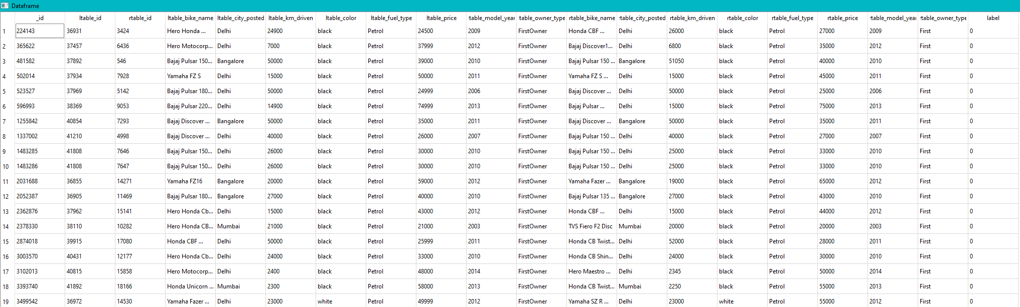
SYSTEMS: MAGELLAN

Slide 11
SYSTEMS: SERF
Research based
No GUI
Java program
New Java class & compiling
No documentation
Only XML data
3 distance methods
Equal fields
Numeric distance
Jaro-Wrinkler distance
Stanford Entity Resolution framework
Notes:
Equal fields
Numeric distance
Jaro-Wrinkler distance

Slide 12
SYSTEMS: FRIL
Research based & Open source
Easy to use GUI
Java program
Good documentation
CSV, Excel, Text, DB
2 modes: Linkage & Deduplication
Attribute merger
Data profiling
5 different blockers
8 distance methods
Debugger
Fine-grained Records Integration and Linkage Tool
Notes:
Equl fields
Soundex
Prefix
Sorted neighbor
SVM Join
Equal fields
Edit distance
Jaro-Wrinkler distance
Q-grams distance
Soundex
Numeric
Date
Street Address

Slide 13
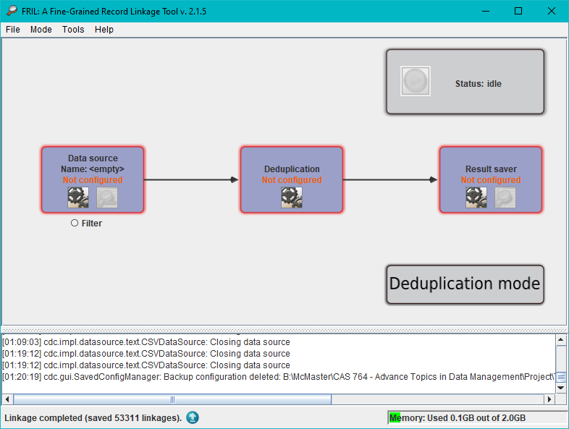
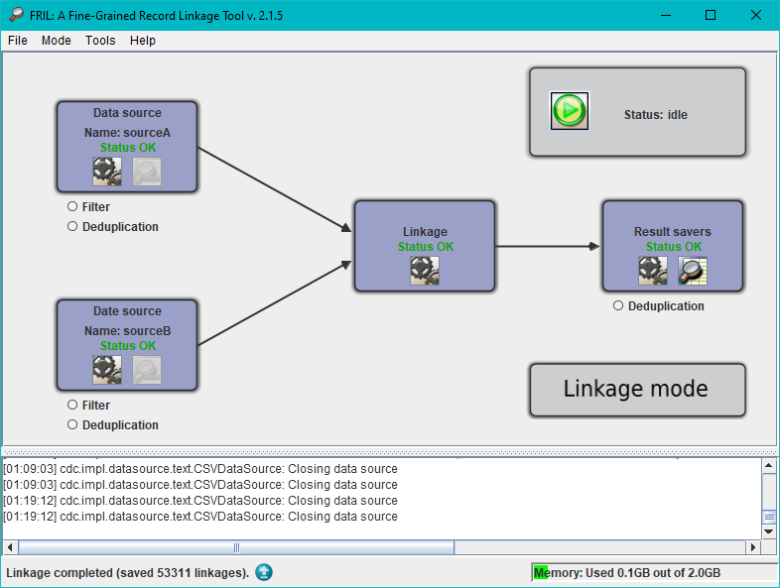
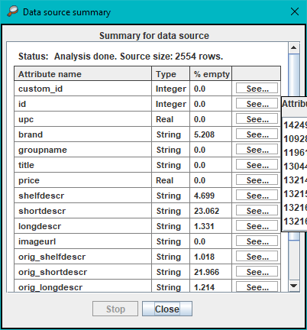
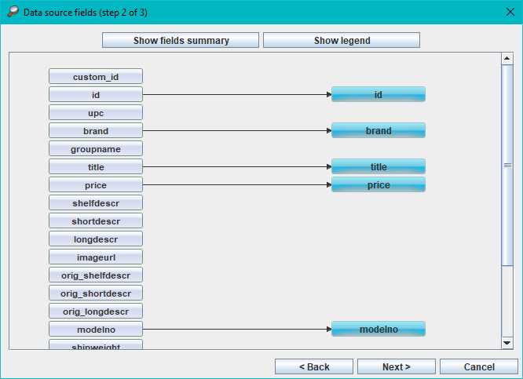
SYSTEMS: fril

Slide 14
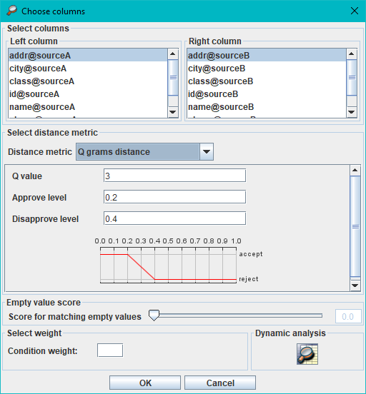
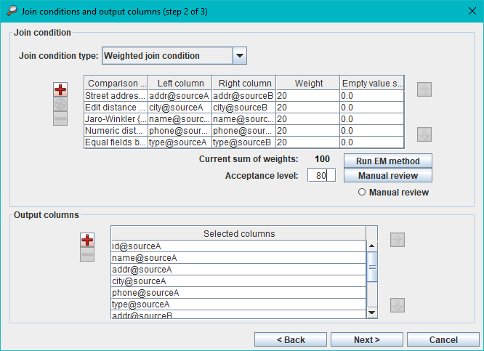
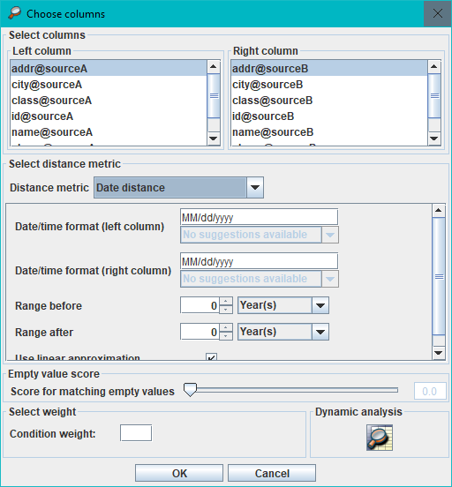
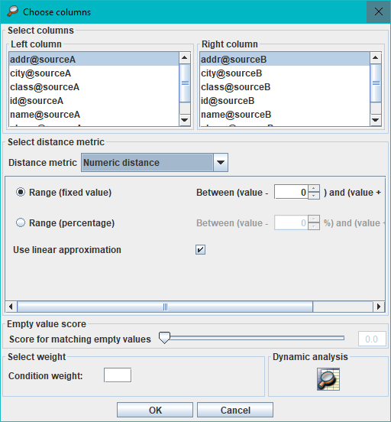
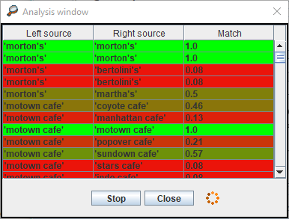
SYSTEMS: fril

Slide 15
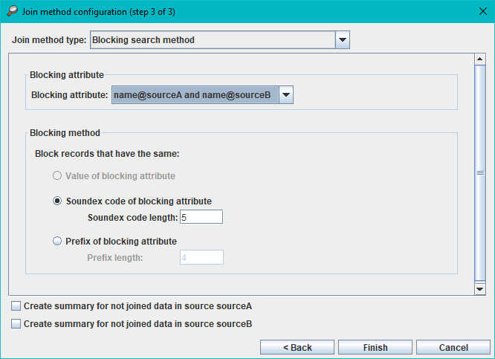
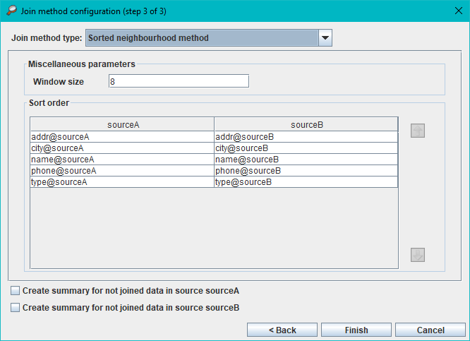
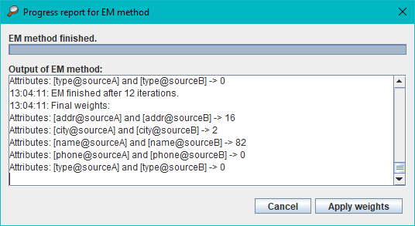
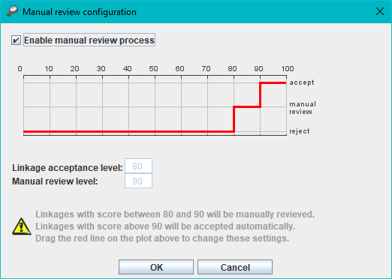
SYSTEMS: fril

Slide 16
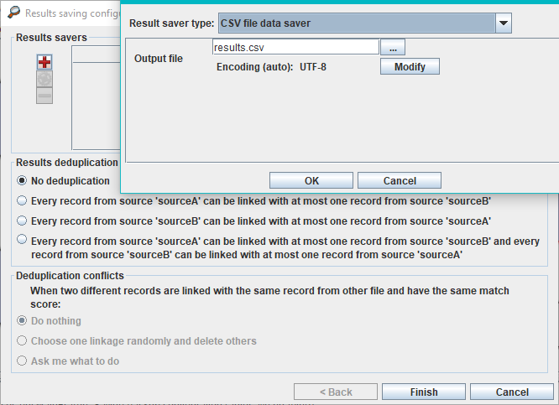
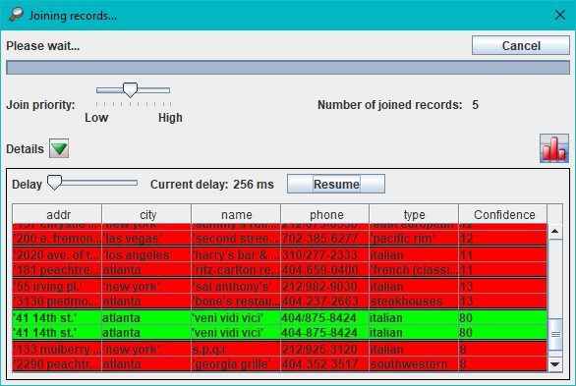
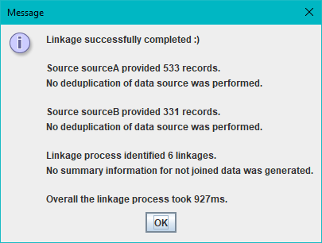
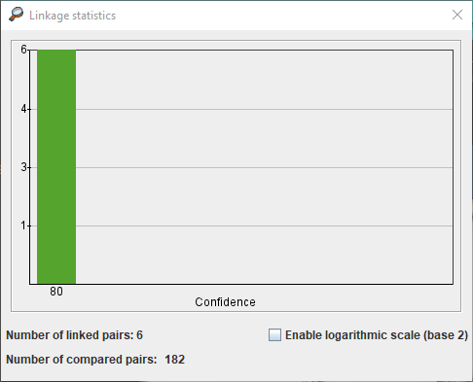
SYSTEMS: fril

Slide 17
SYSTEMS: Data ladder
Commercial (30 days free trial)
Great GUI
No requirements
Good documentation
CSV, Excel, Text, DB, social media
Data profiling
Address Verification (GPS)
Cleaning & Standardization
2+ dataset linkage
4 distance methods
Detailed results
Merger
Notes:
Upper-lowercase
Remove/change characters
Only letters/numbers
Create patterns
Separates name and address data
Exact
Phonetic
Fuzzy
Numeric

Slide 18
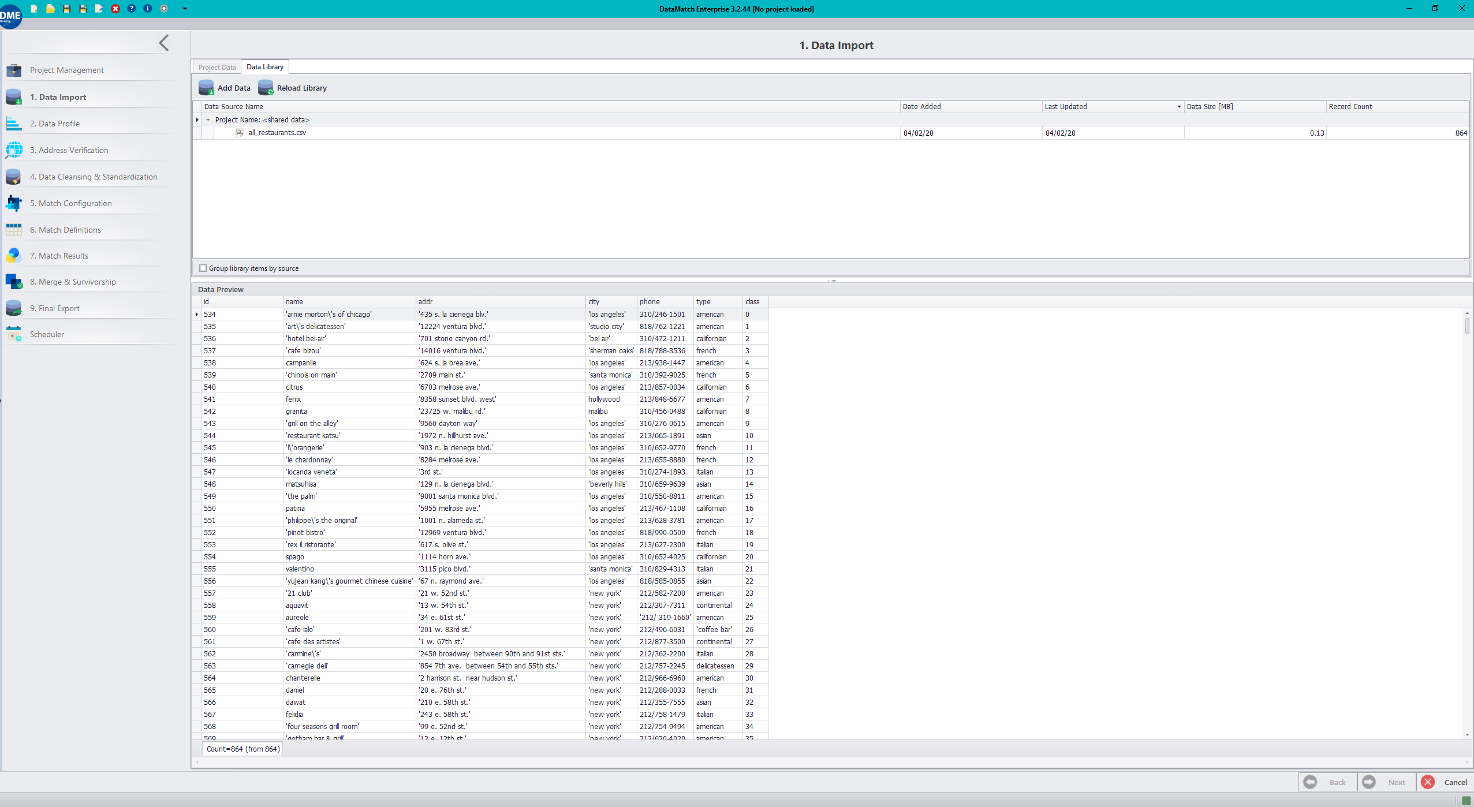
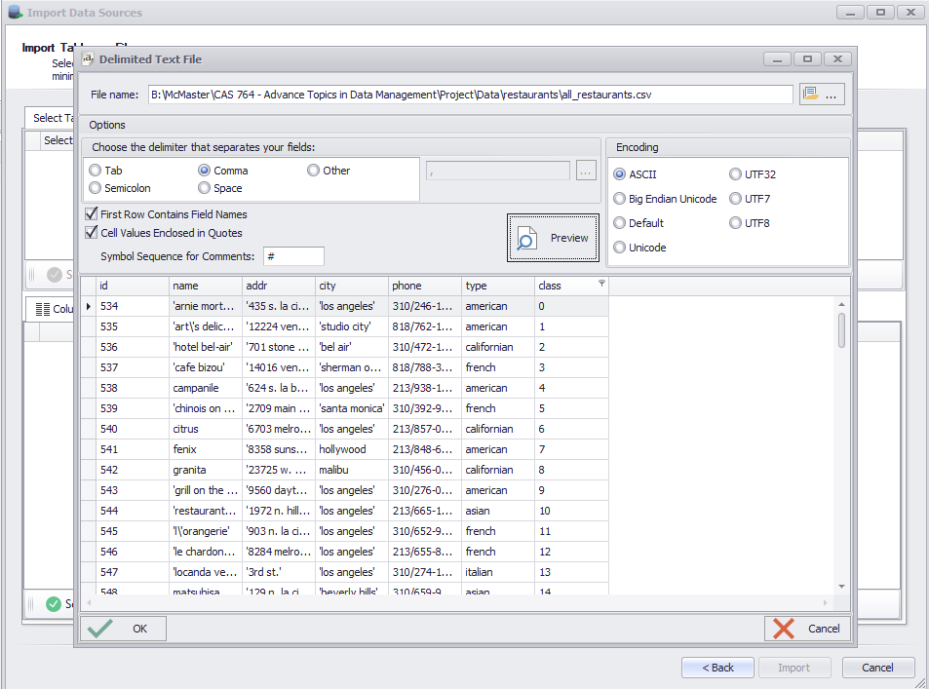
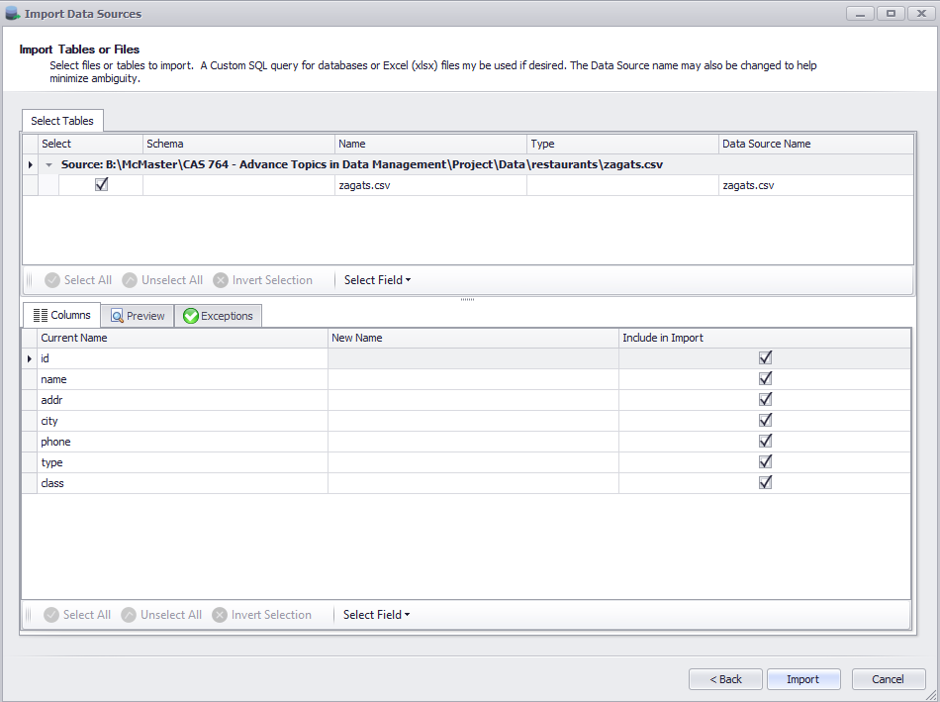
Notes:
Window

Slide 19
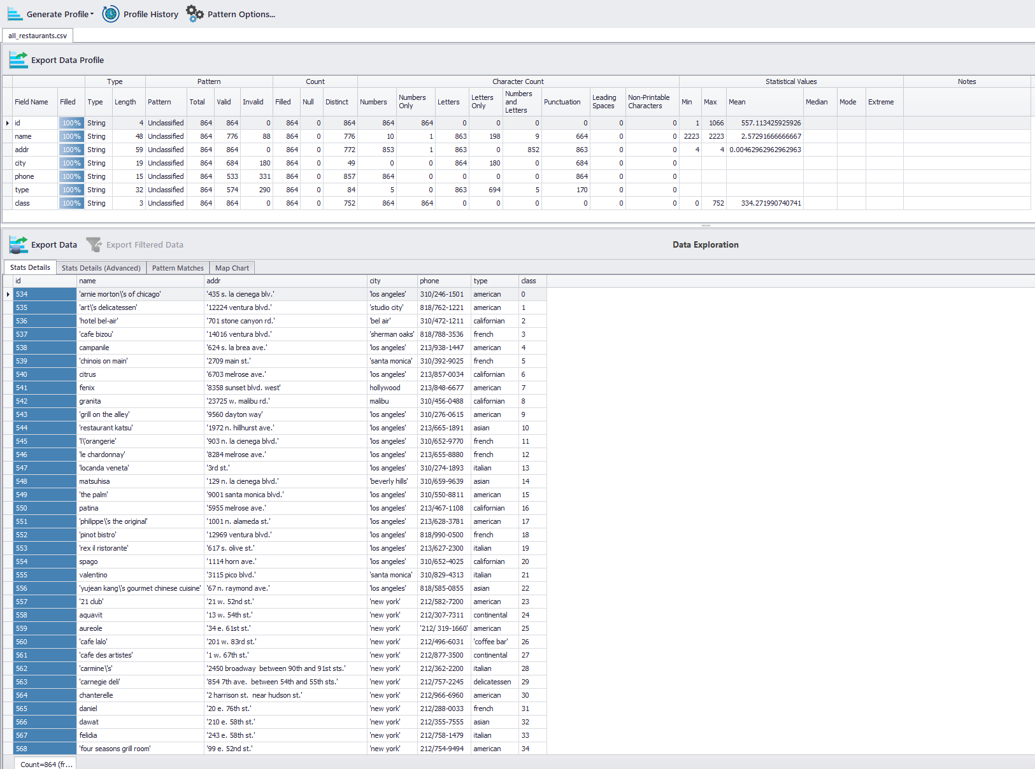
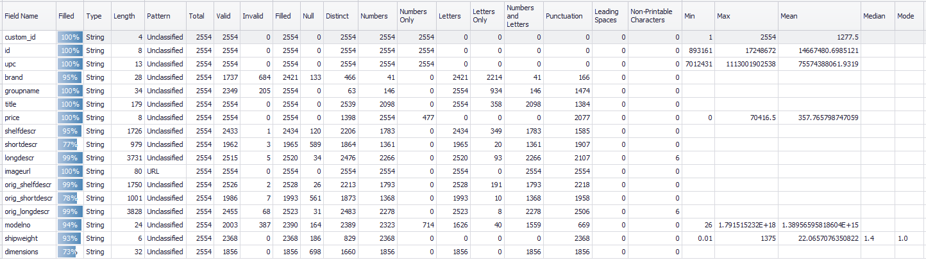
Data
Profiling
Notes:
Profiling

Slide 20
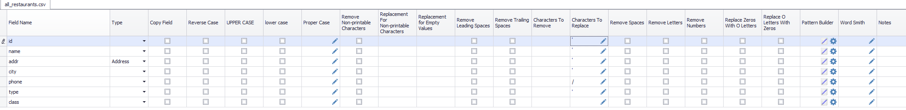
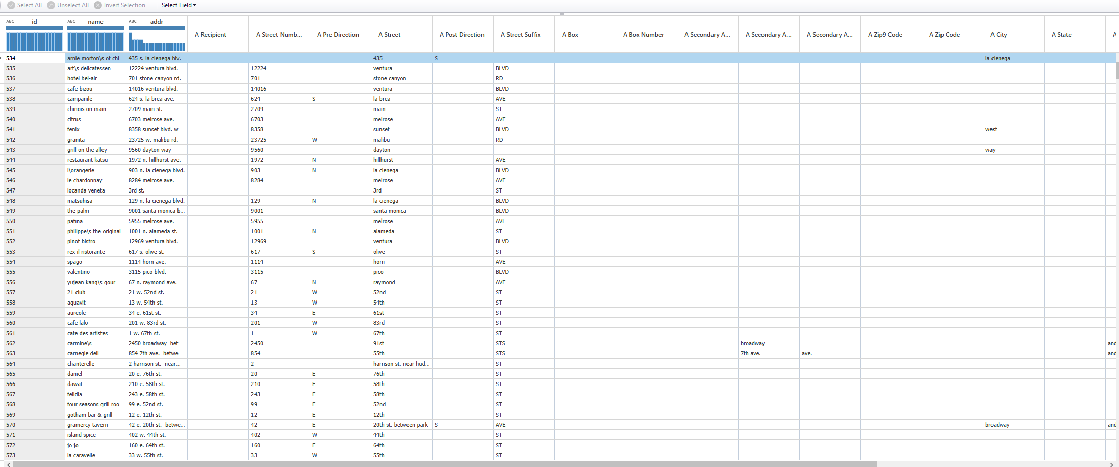
Data
Profiling
Notes:
Cleansing & Standardization

Slide 21
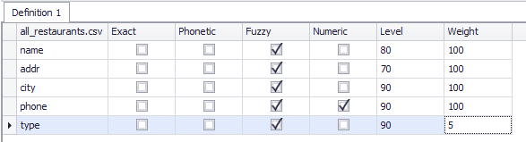
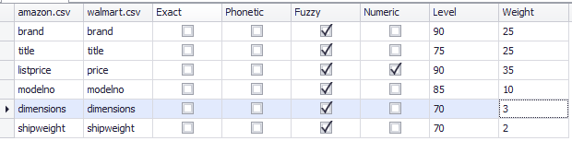
Matcher
Notes:
Window

Slide 22
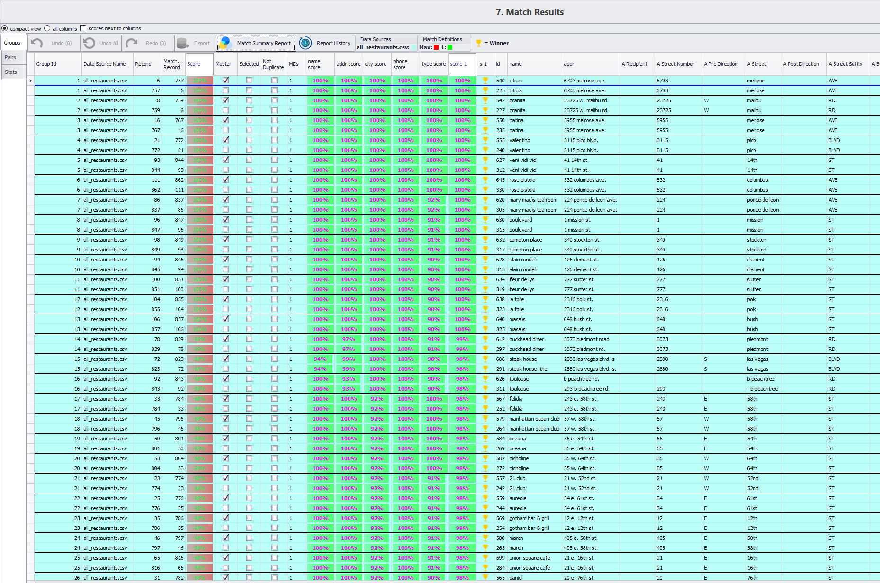
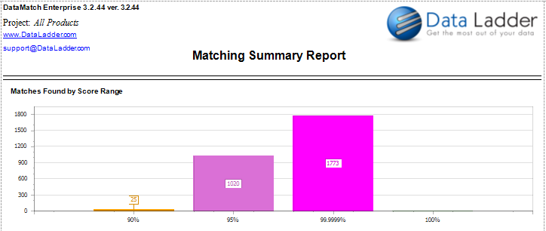
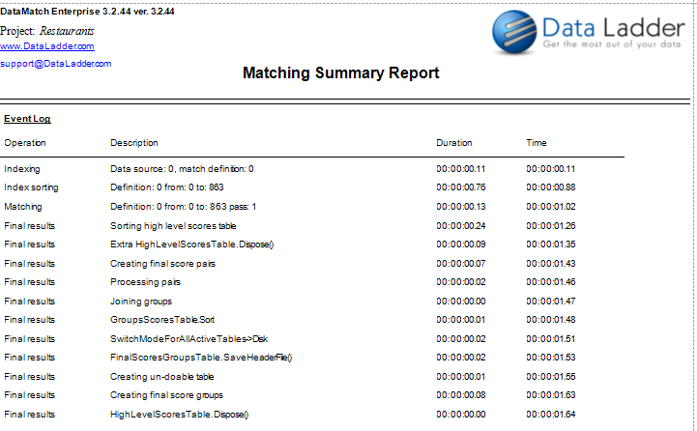
results
Notes:
Window

Slide 23

Experiments & evaluation
Same environment for all systems
System Specs:
CPU: Intel I7 4710MQ @ 2.5 GHz (Boost: 3.5 GHz), 4 Cores – 8 Threads
RAM: 16GB DDR3
OS: Windows 10 Home (64 bit)
HDD connection: SATA @6Gb/s

Slide 24
Experiments & evaluation
 | Bikes | Restaurants | Citations | Products
Magellan (Debug) | 1:02:16.351765 | 1:14:12.730028 | Error | 0:45:50.580760
Magellan (Script) | 0:06:29.10728 (incl. labeling) | 0:01:50.75810 (incl. labeling) | Error | 0:06:08.167443 (incl. labeling)
FRIL (Linkage) | 00:02:25.935 (145935ms) | 00:00:02.988 (2988ms) | 05:20:25.722 (19225722ms) | 00:00:05.849 (5849ms)
FRIL (Deduplication) | 00:02:47.507 (167507ms) | 00:00:00.181 (181ms) | 02:47:14.080 (10034080ms) | 00:00:01.573 (1573ms)
Data Ladder | 00:00:02.71 | 00:00:01.64 | 00:05:59.95 (2M tuples) | 00:00:04.91
RUNTIMES

Slide 25
Experiments & evaluation
Accuracy: Precision

Slide 26
Accuracy: Recall

Slide 27
Accuracy: F1

Slide 28

Future work
Finish the experiments
SERF
Febrl
SAS Data Flux
Report
Additional systems

Slide 29
references
[1] Konda, Pradap, et al. "Magellan: Toward building entity matching management systems." Proceedings of the VLDB Endowment 9.12 (2016): 1197-1208.
[2] Benjelloun, Omar, et al. "Swoosh: a generic approach to entity resolution." The VLDB Journal 18.1 (2009): 255-276.
[3] Jurczyk, Pawel, et al. "FRIL: a tool for comparative record linkage." AMIA annual symposium proceedings. Vol. 2008. American Medical Informatics Association, 2008.
[4] Christen, Peter. "Febrl- an open source data cleaning, deduplication and record linkage system with a graphical user interface." Proceedings of the 14th ACM SIGKDD international conference on Knowledge discovery and data mining. 2008.
[5] Köpcke, Hanna, and Erhard Rahm. "Frameworks for entity matching: A comparison." Data & Knowledge Engineering 69.2 (2010): 197-210.
[6] Barateiro, José, and Helena Galhardas. "A survey of data quality tools." Datenbank-Spektrum 14.15-21 (2005): 48.
[7] Bharambe, Dewendra, Susheel Jain, and Anurag Jain. "A survey: detection of duplicate record." International Journal of Emerging Technology and Advanced Engineering 2.11 (2012): 298-307.
[8] Elmagarmid, Ahmed K., Panagiotis G. Ipeirotis, and Vassilios S. Verykios. "Duplicate record detection: A survey." IEEE Transactions on knowledge and data engineering 19.1 (2006): 1-16.
[9] Christen, Peter. "A survey of indexing techniques for scalable record linkage and deduplication." IEEE transactions on knowledge and data engineering 24.9 (2011): 1537-1555.
[10] Patil, Aparna Ajit, and Dhanashree Kulkarni. "A survey on: secure data deduplication on hybrid cloud storage architecture." International Journal of Computer Applications 110.3 (2015).

Slide 30
Thank YOU!

